Slide 1
MPPL
Kelompok A08
Dely Teja Mukti (5115100003)
Yoga Samudra (5115100080)
Ilham Febriyanto (5115100083)

Slide 2
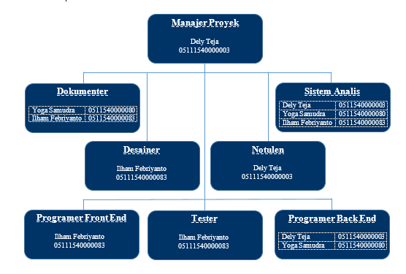

Slide 3
Project Manager
1. Struktur Organisai

Slide 4
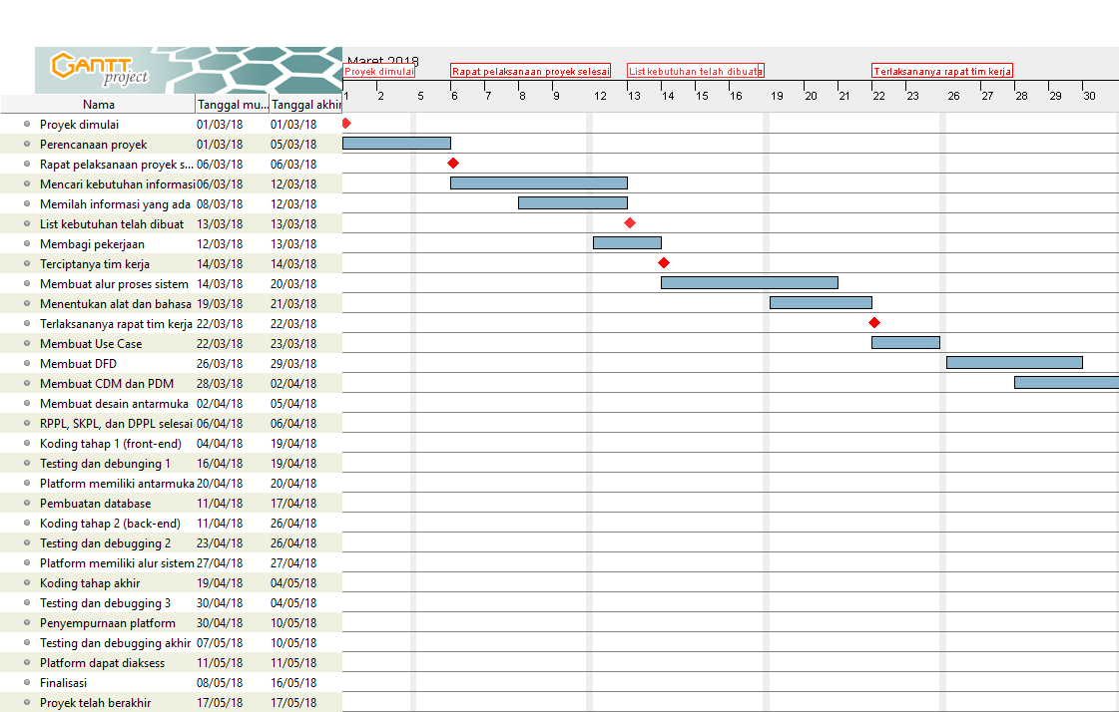
2. Timeline dan alokasi staf

Slide 5
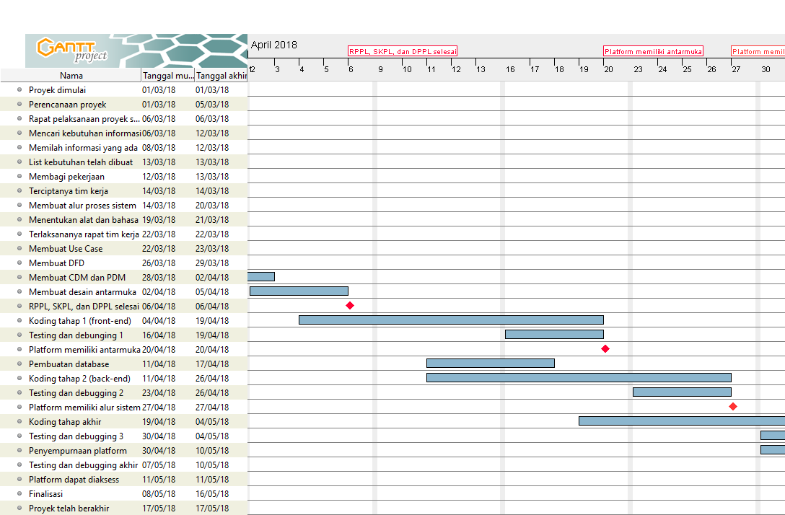

Slide 6
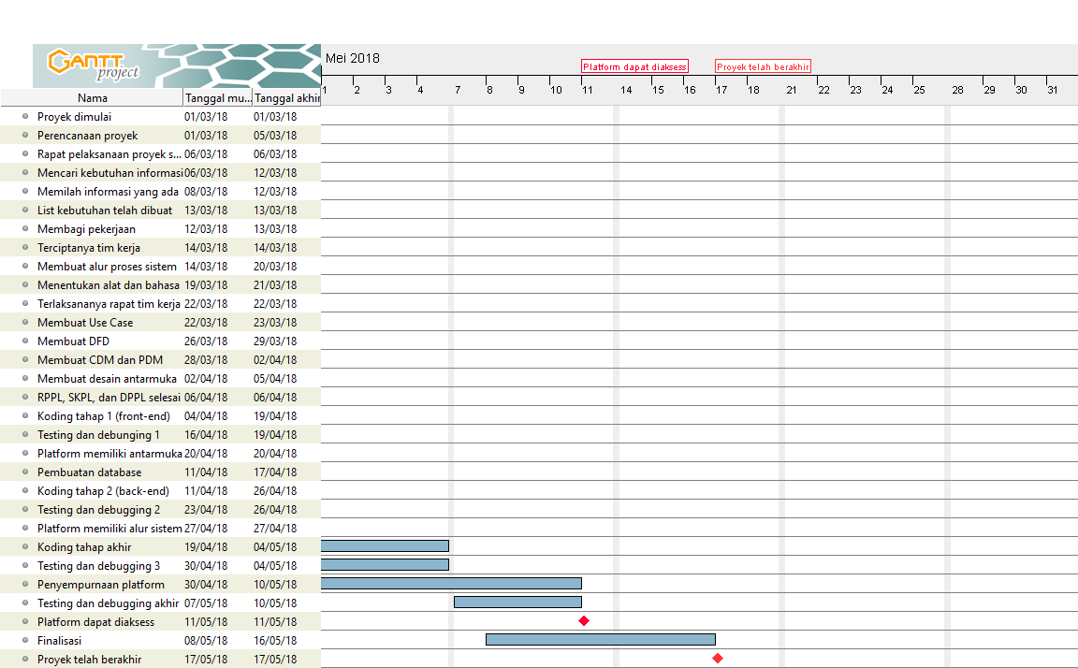

Slide 7
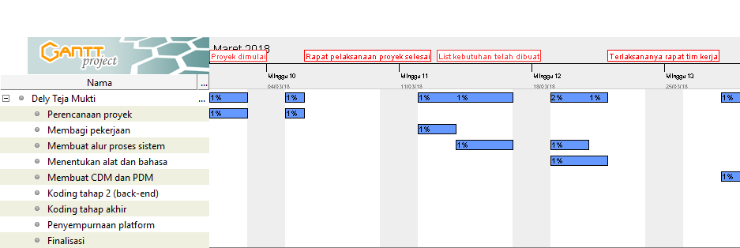
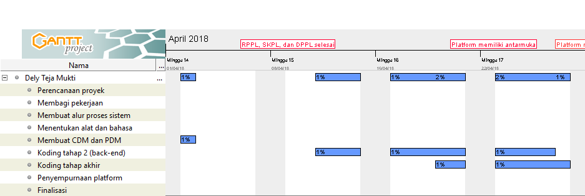
Alokasi Staf
Dely Teja 5115100003

Slide 8
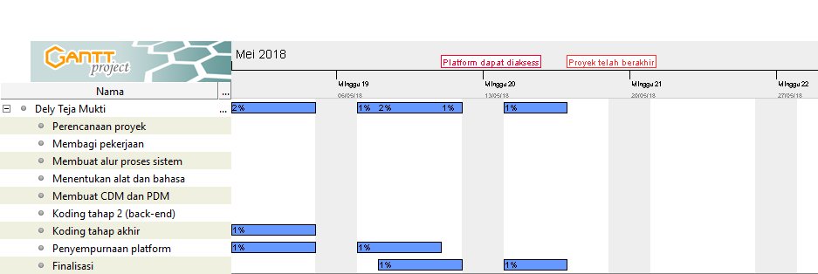
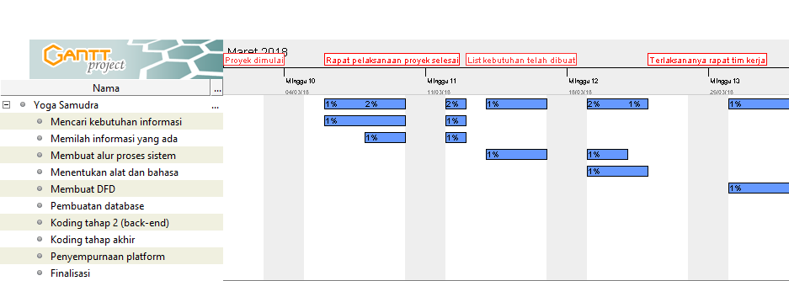
Yoga Samudra 5115100080

Slide 9
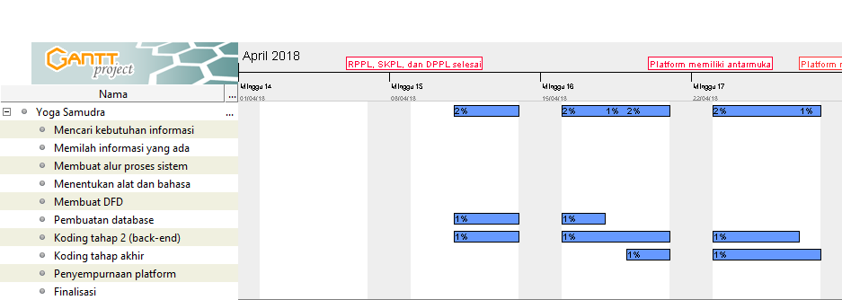
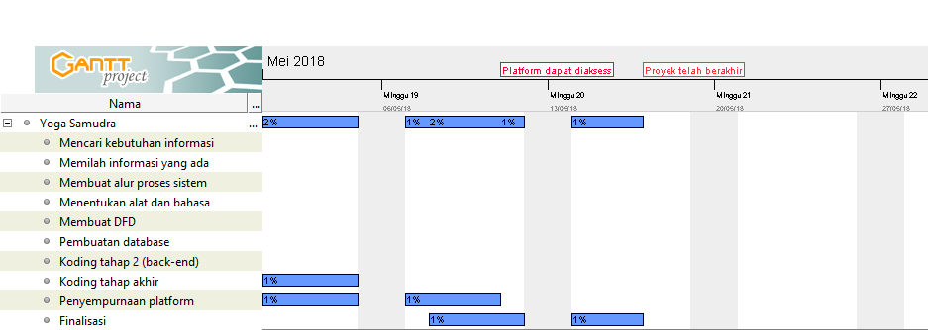

Slide 10
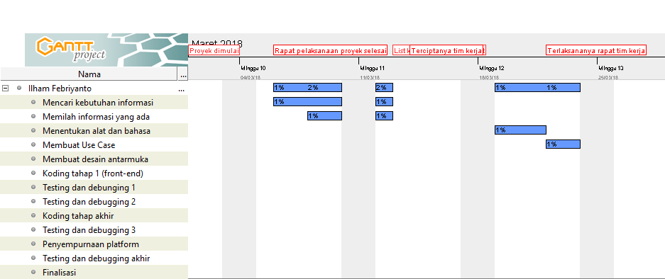
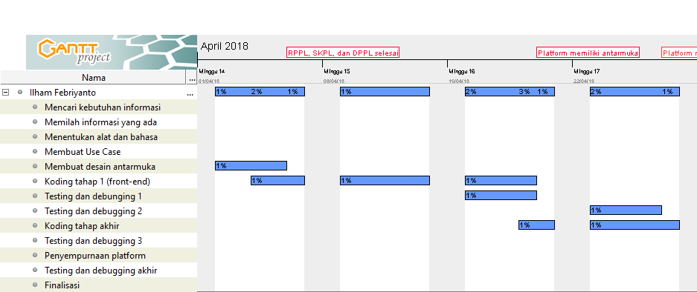
Ilham Febriyanto 5115100080

Slide 11
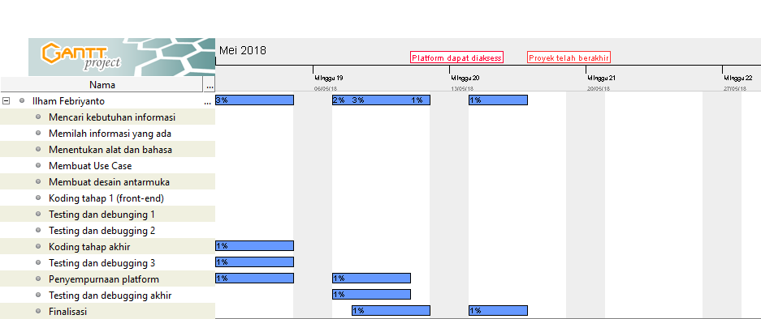

Slide 12
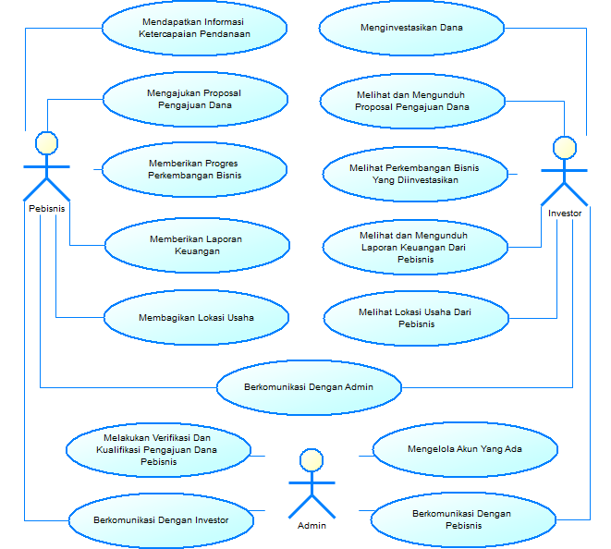
Analys
Use Case
Ilham Febriyanto

Slide 13
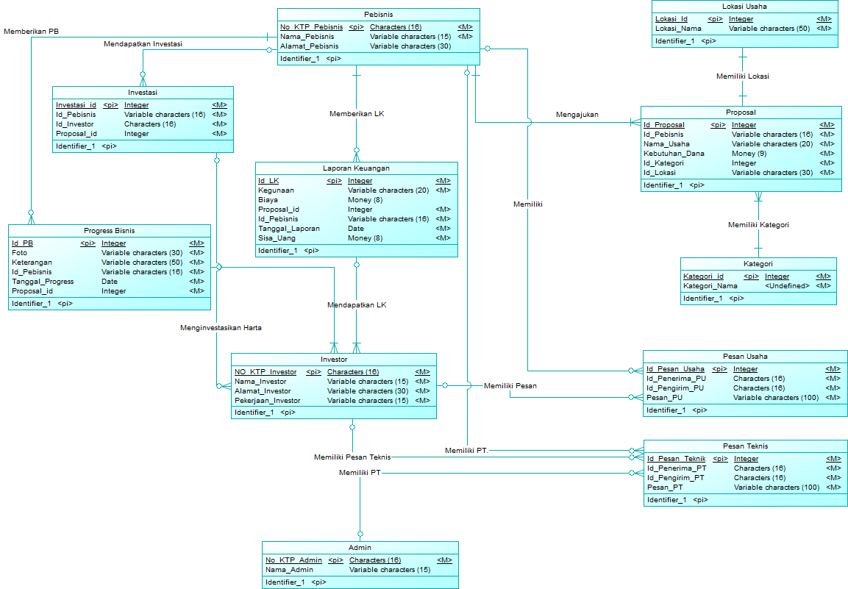
CDM PDM
Dely Teja M

Slide 14
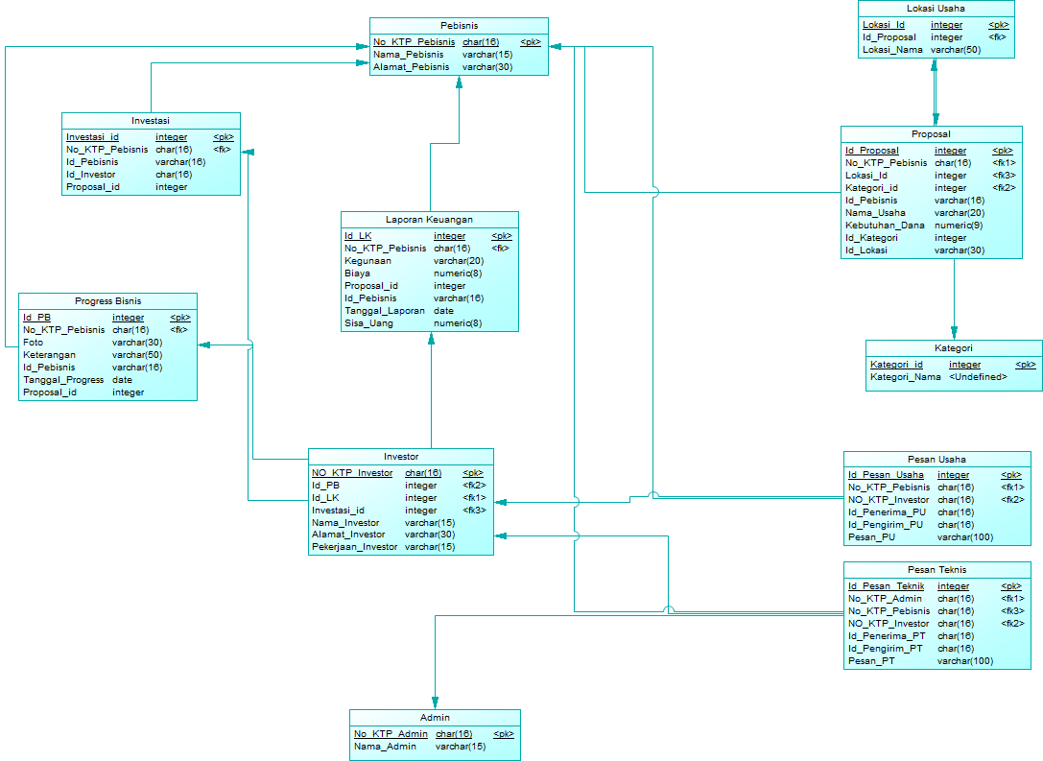
PDM
Dely Teja M

Slide 15
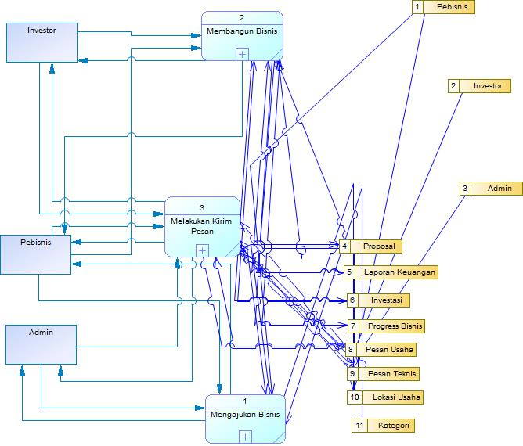
DFD
Yoga Samudra

Slide 16
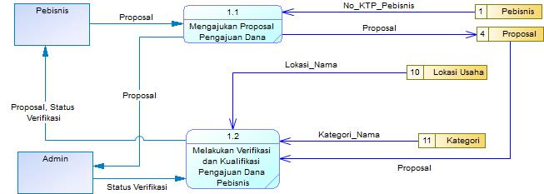
DFD
Yoga Samudra

Slide 17
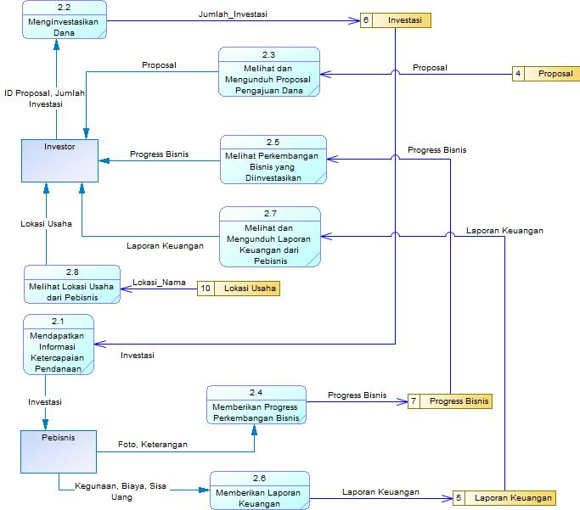
DFD
Yoga Samudra

Slide 18
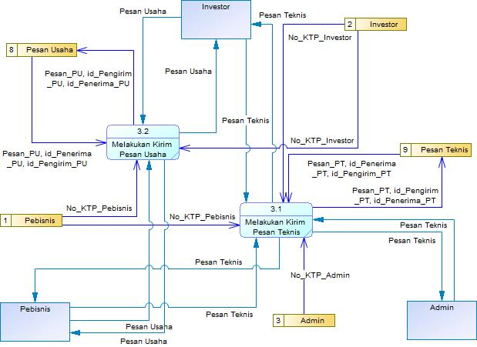
DFD
Yoga Samudra

Slide 19
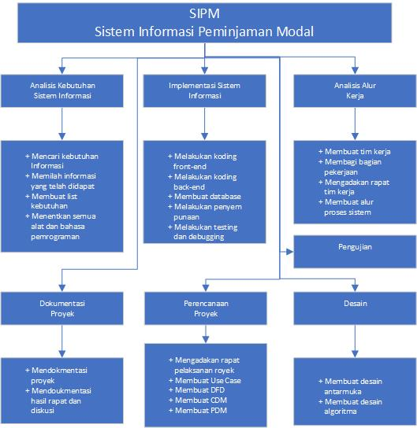

Slide 20
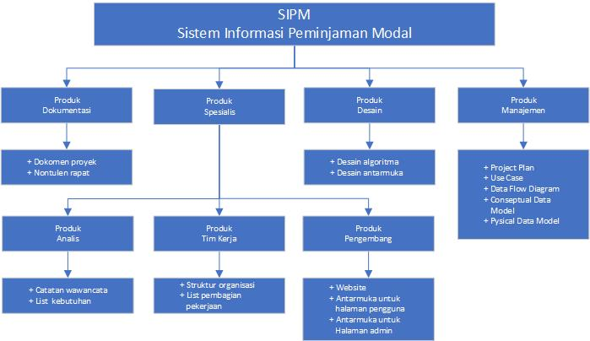

Slide 21
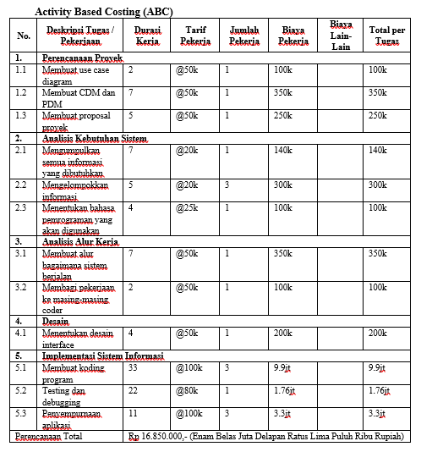

Slide 22
